Slide 1
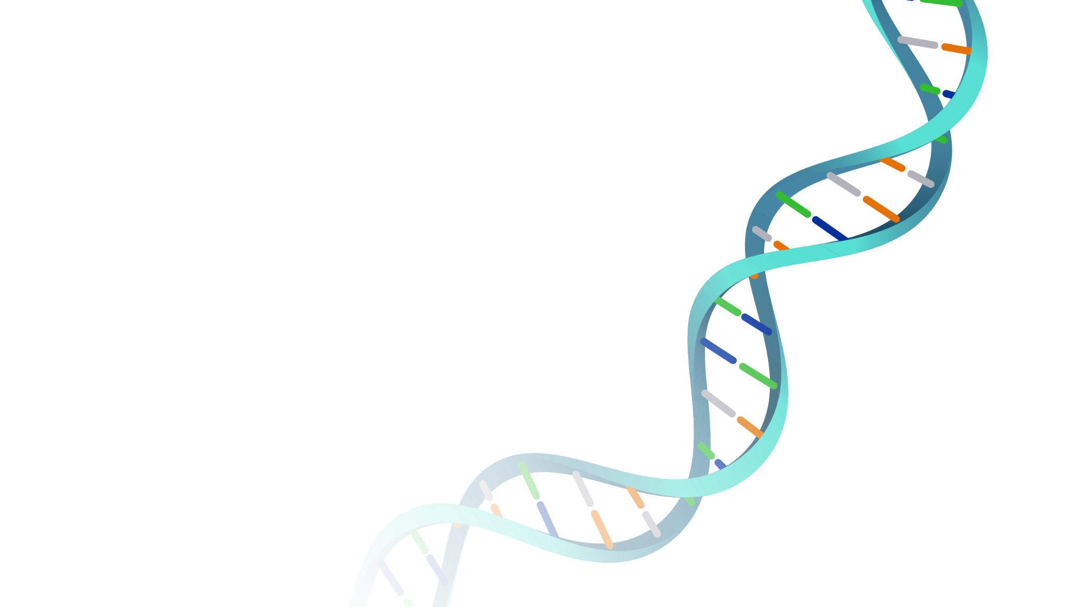
Genetic Algorithms
Sean Peng, Ron Guter, Quintin Buckley

Slide 2
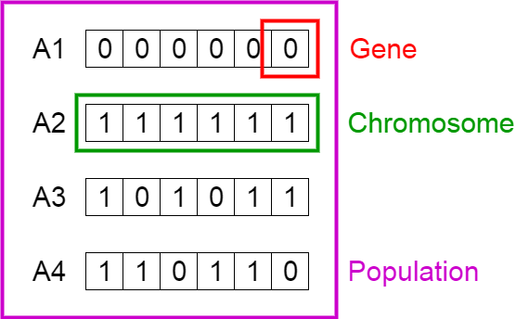
What are Genetic Algorithms (GAs)?
Method of solving optimization problems, inspired by natural selection
A heuristic algorithm, not analytic
Each candidate solution is an array called a chromosome
The initial population is randomly generated
The solutions improve over generations

Slide 3
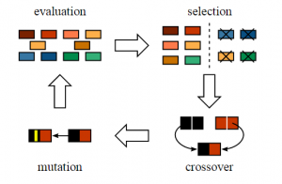
Four Stages of GA
For each generation:
Evaluation: calculate a score for each chromosome
Selection: the best chromosomes become parents
Crossover: the parents combine and reproduce
Mutation: random change of part of a chromosome at a very low probability (flipping a bit).

Slide 4

Evaluation
Calculate the fitness for each chromosome
Ex. For an algorithm where each chromosome has 2 parameters, a fitness function could be
For maximizing, higher fitness indicates a better solution
For minimizing, lower fitness indicates a better solution
Better solutions dictate the general direction of the evolution process

Slide 5
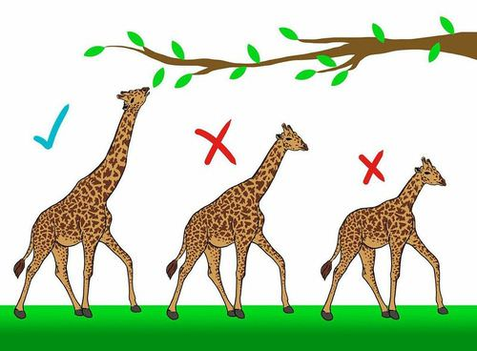

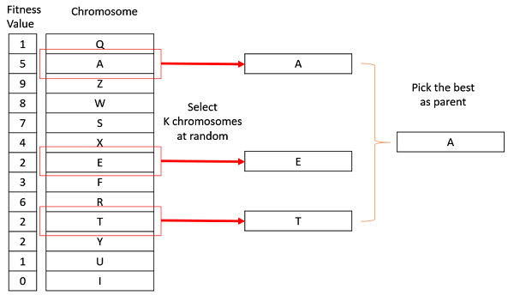
Selection
Some high fitness chromosomes in the current generation become parents
Many different selection methods
Roulette Wheel Selection (for the ith chromosome)
Tournament Selection
Break population into groups of k
The fittest of each group is selected

Slide 6
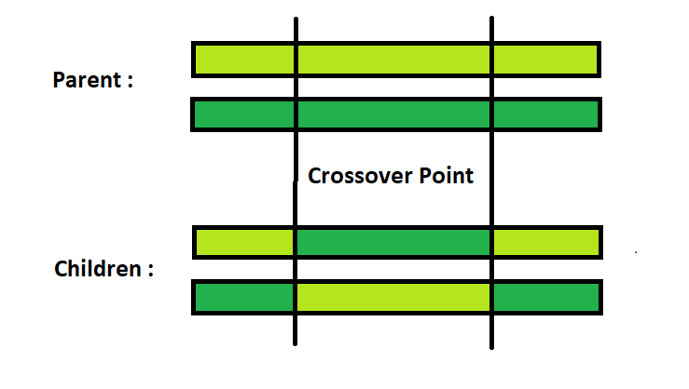
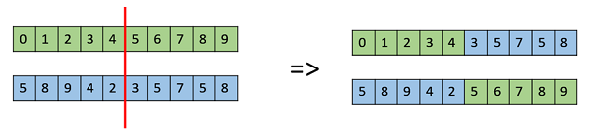
Crossover
Selected parents will "reproduce" by swapping segments of their genes, based on randomized crossover point(s).
Ex. P1 = 11111, P2 = 00000, one crossover point at bit 2
Child 1 = 11000, Child 2 = 00111
Potentially combine the best features of the parents

Slide 7
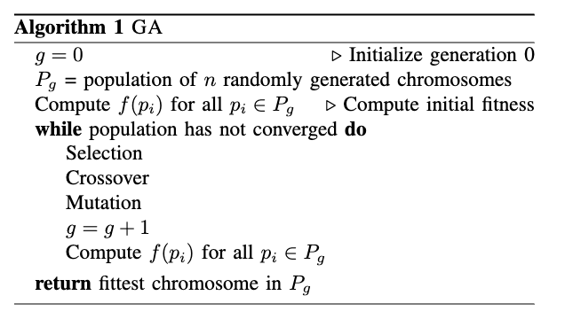
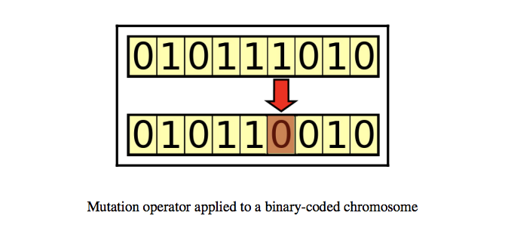
Mutation
Randomly flips bits in a chromosome at a very low probability
Inspired by nature, maintains genetic diversity
Prevents the algorithm from getting stuck at local optima before finding the global optimum
Advantage over other algorithms, e,g. gradient descent

Slide 8

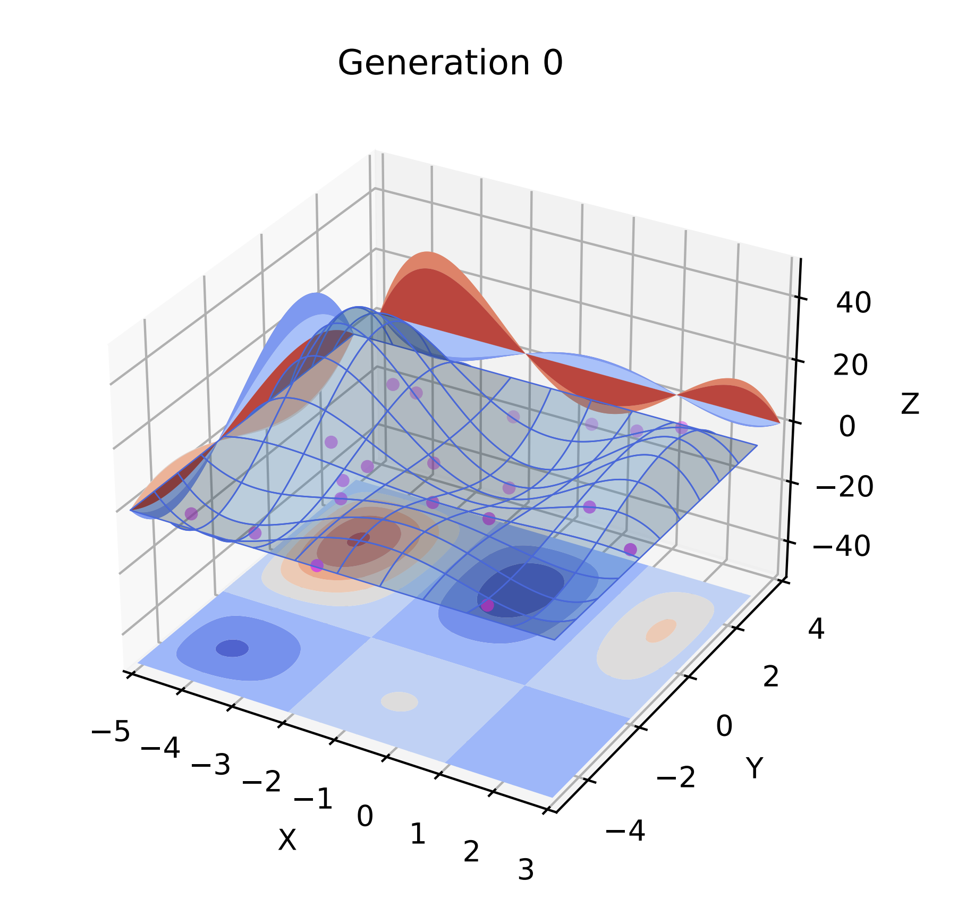
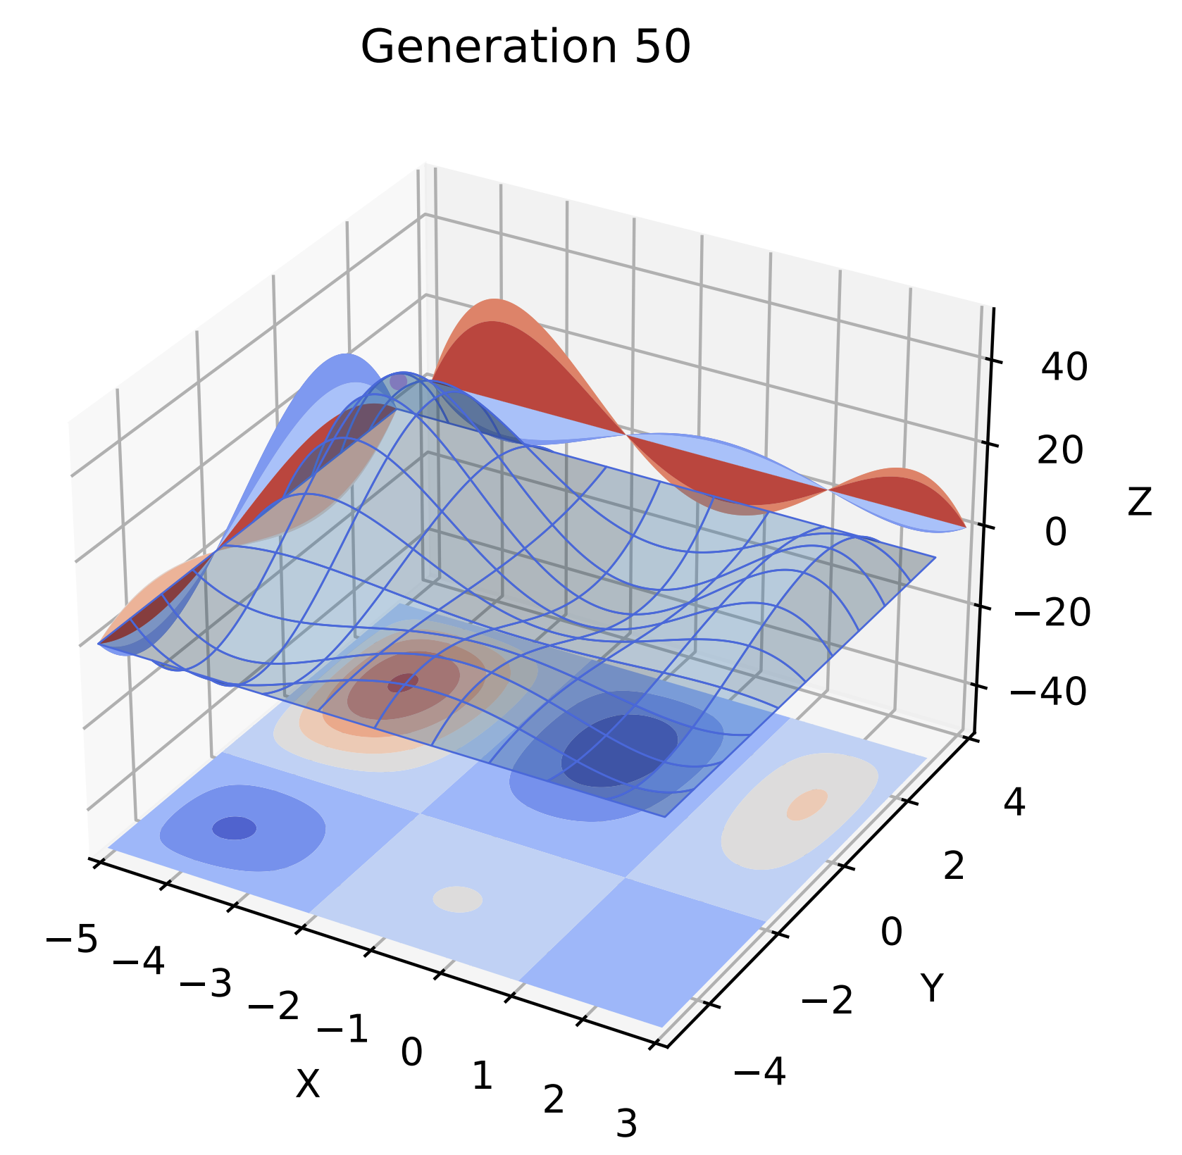
Simple Function Optimization
Maximize
Constrained domain:
This is our fitness function
Population size: 20 chromosomes
Tournament selection: k = 3, Crossover rate = 0.8, Mutation rate = 0.1

Slide 9
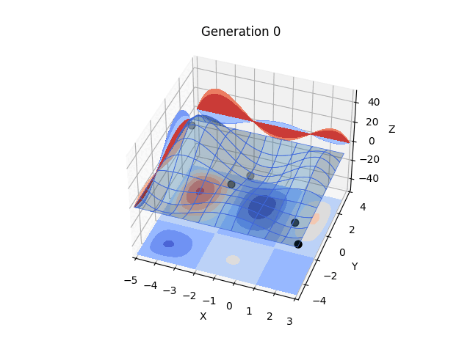
Improving GA
Genetic algorithms follow a simple set of rules
This makes them easier to understand and modify
What if we combined GA with other kinds of optimization methods?

Slide 10

Particle Swarm Optimization (PSO)
Another heuristic algorithm
Instead of “chromosomes,” we have a “swarm” of random “particles”
Each particle starts with a random initial velocity in a random direction
At every iteration (t), every particle (X_{i}) steps in the direction of its velocity
At every iteration, every particle calculates its new velocity (V_{i} ) using the equation
ω, c₁, and c₂ are preset hyperparameters on [0, 1]
𝜙₁ and 𝜙₂ are randomly selected numbers on [0, 1]

Slide 11
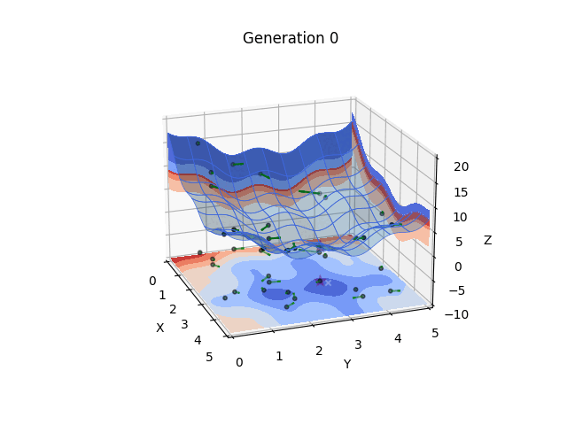
What does this mean?
Every particle tracks its own best position over time (pbest_{i}) and the swarm’s overall best (gbest)
At every step, a particle’s velocity will gradually shift towards both its personal best and the swarm’s global best
We both “explore” a particle’s individual results and “exploit” the knowledge of the entire swarm

Slide 12
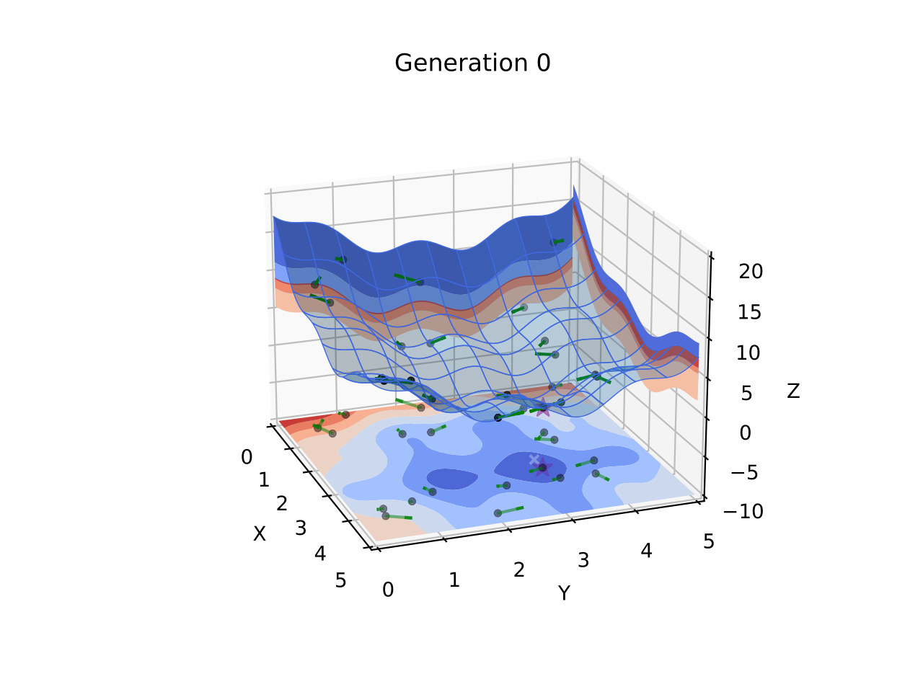

A Hybrid of Genetic Algorithms and Particle Swarm (HGAPSO)
Apply the principles of exploration and exploitation to a genetic algorithm
Give each chromosome a velocity, and for every generation:
Step (“enhance”) each chromosome in the direction of its velocity
Compute every chromosome’s new velocity with the same equation as in PSO
Apply selection, crossover, and mutation to these “enhanced chromosomes”
Repeat

Slide 13

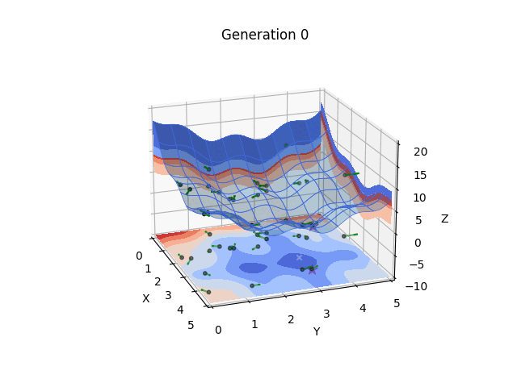
Standard GA vs. HGAPSO
Both algorithms tested on the function
On average, HGAPSO was able to find a solution within one-hundredth of the true global minimum in fewer generations than the standard GA could
Even better results could be achieved by finding optimal hyperparameters

Slide 14
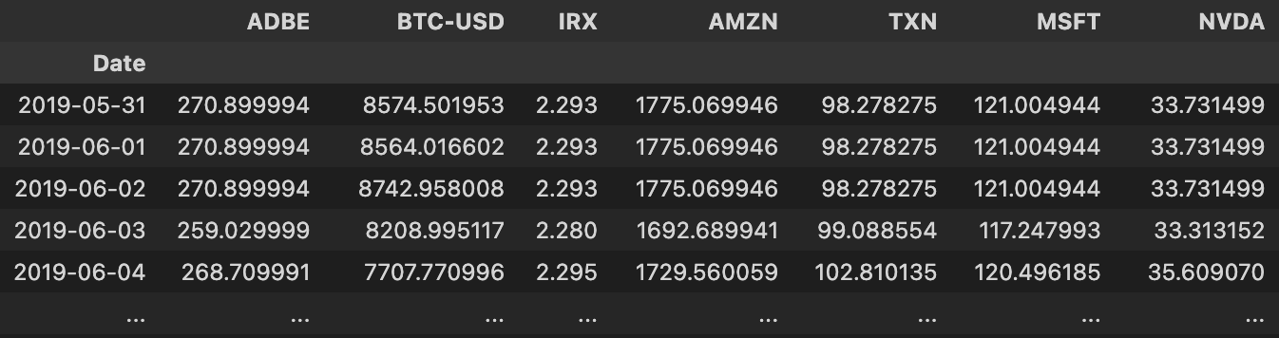
Application to Portfolio Optimization
A portfolio is a partition of the total capital, with each portion is allocated to a different asset
We can build an optimal portfolio based off some metric (fitness function) using GAs
We used data sets from Yahoo Finance to get the stock prices of companies from 2019–2021.

Slide 15

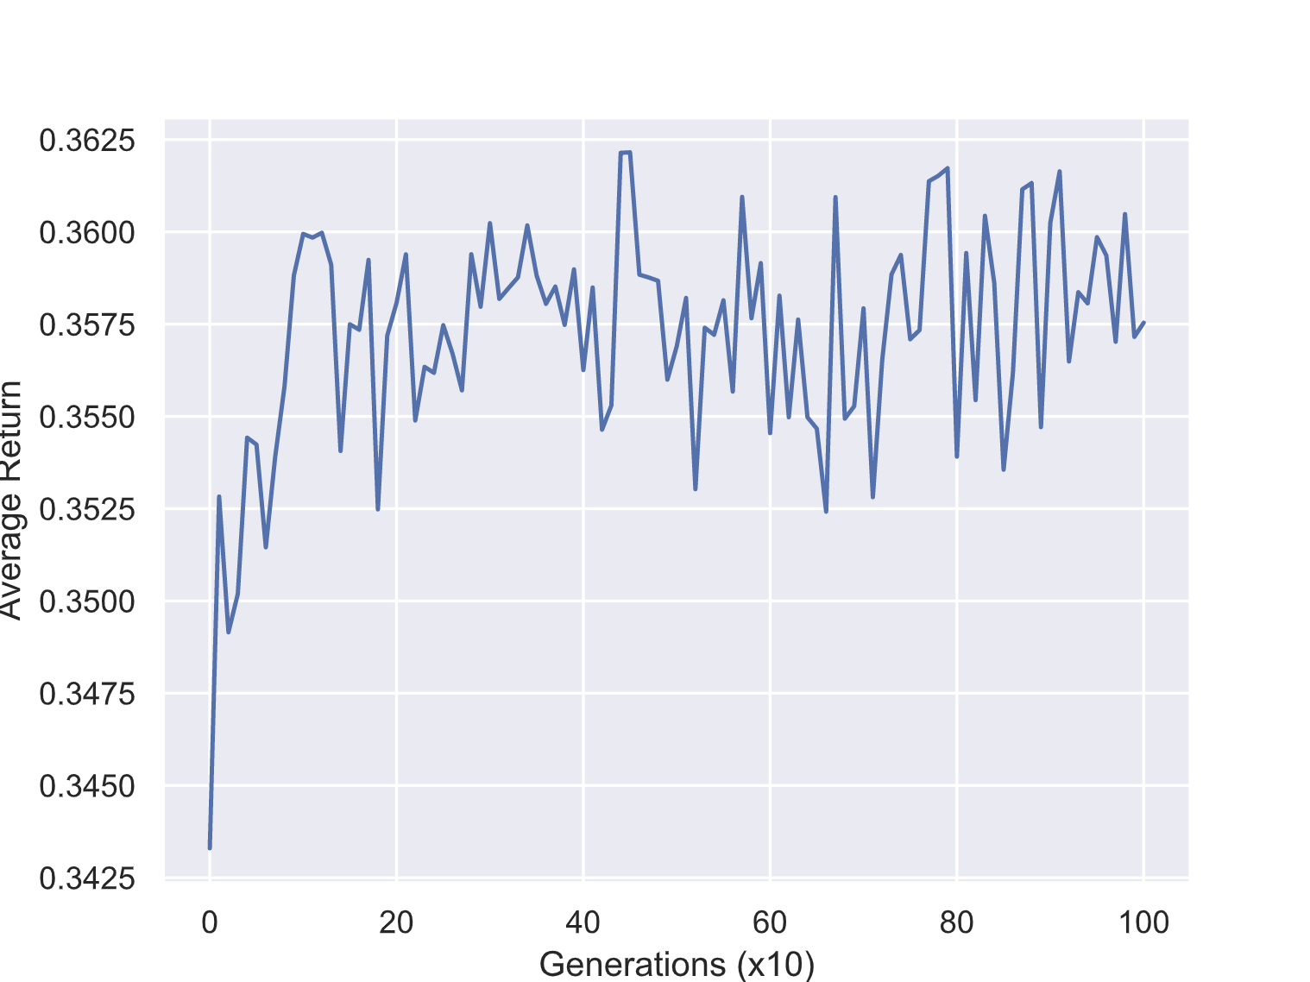
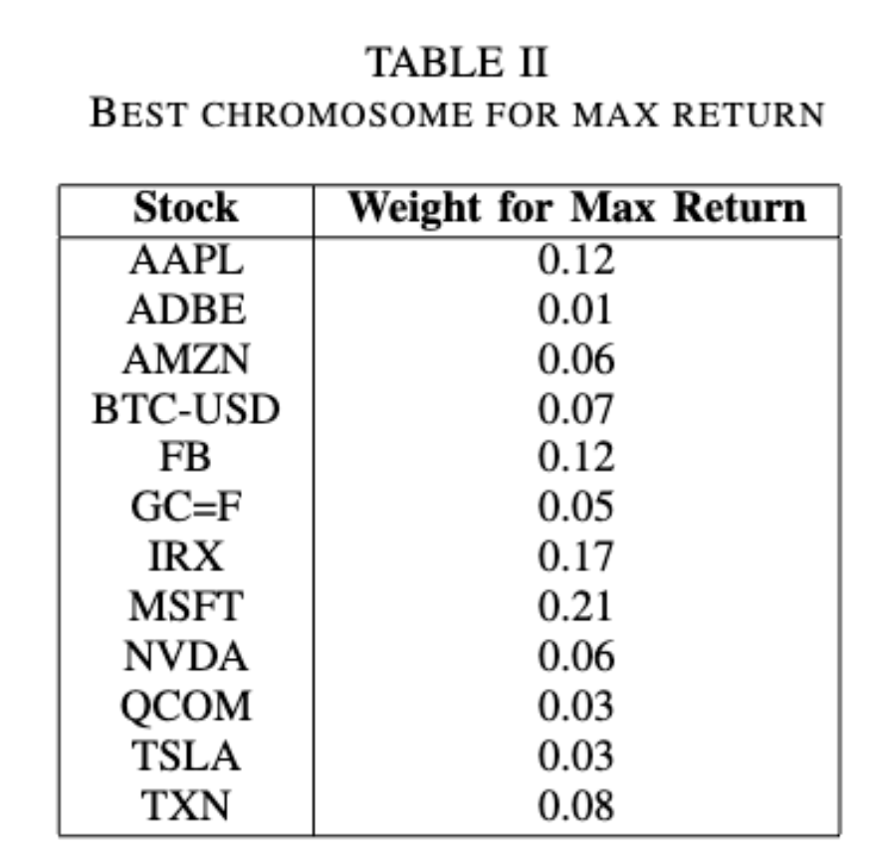
Defining the Stages
Chromosome: each chromosome is a partition that sums to 1 (the total capital)
Fitness function: expected return
Selection: top third of the current generation
Crossover: Random constant k, the computation for parents a, b
Mutation: Randomly transferring capital from one asset to another

Slide 16
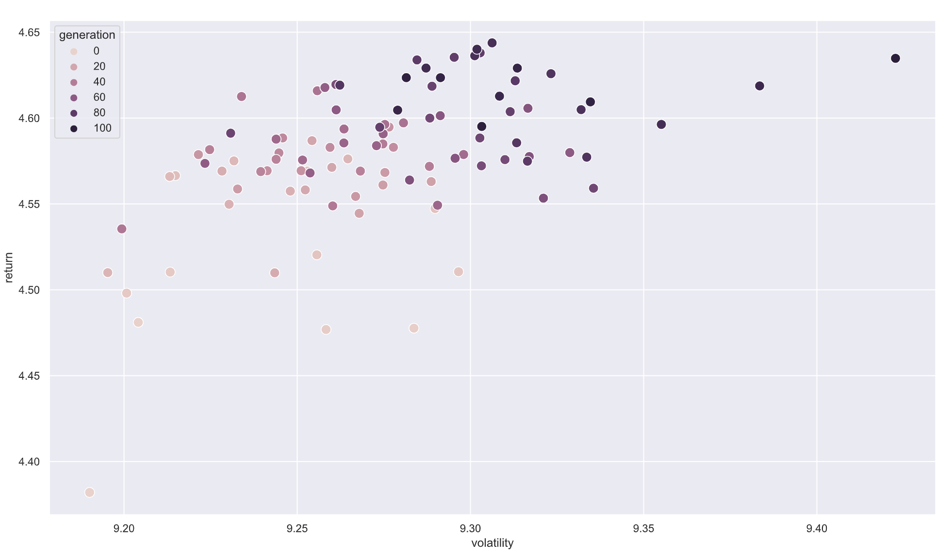

Improvement Using the Sharpe Ratio
Original fitness function focused on returns, but doesn't account for risk
resulted in high volatility
Better metric: Sharpe ratio (reward-to-variability ratio)
Achieved 0.5738 Sharpe ratio with 6.21% returns
> 0.5 means well-diversified portfolio

